Slide 1

Ticket Please!!!
Book your favorite
movie tickets.

Slide 2

Group Members
Priyanka jain rit2014021
Apoorva rit2014044
Shradha sharma rit2014087
Neha kumari rit2014091
Heena meena rit2014092

Slide 3

Softwares used
Mysql
Netbeans
Sqlyog

Slide 4
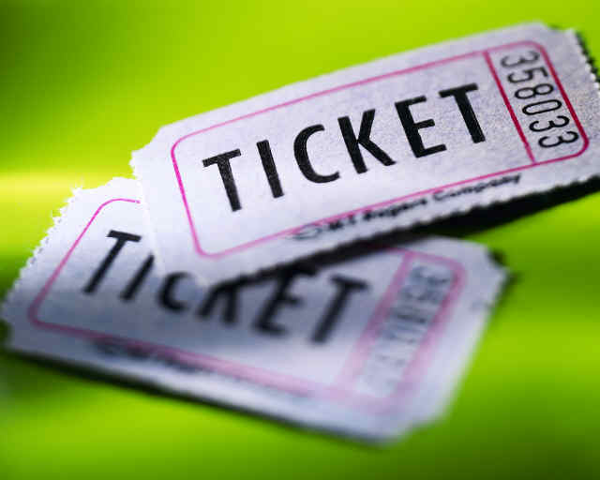
This project will help
you to book movie
Tickets at your nearby
cinema hall.

Slide 5

The user will have to
follow the following
steps

Slide 6

First the customer selects the area where he wishes to go.
Then he/she selects the movie.
Then he/she selects the desired timing.
Then he/she selects the type of seats and enter number of seats.
Then he/she selects the seats.
Then he/she makes the payment.
Finally he/she can print the tickets generated.

Slide 7
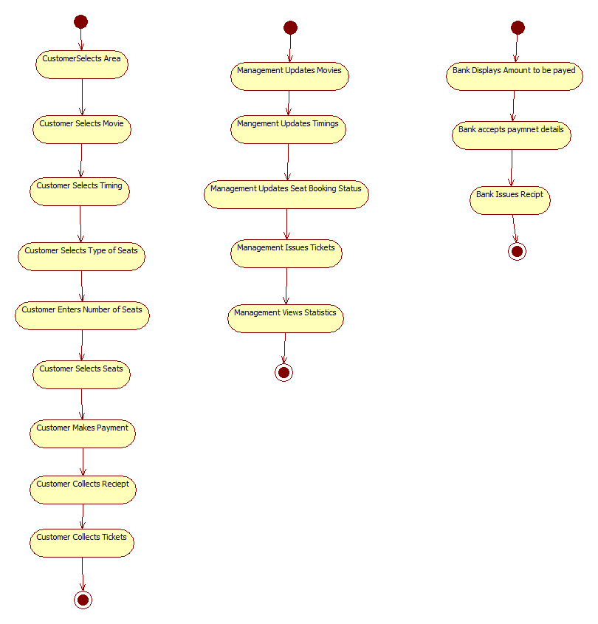
Activity Diagram

Slide 8
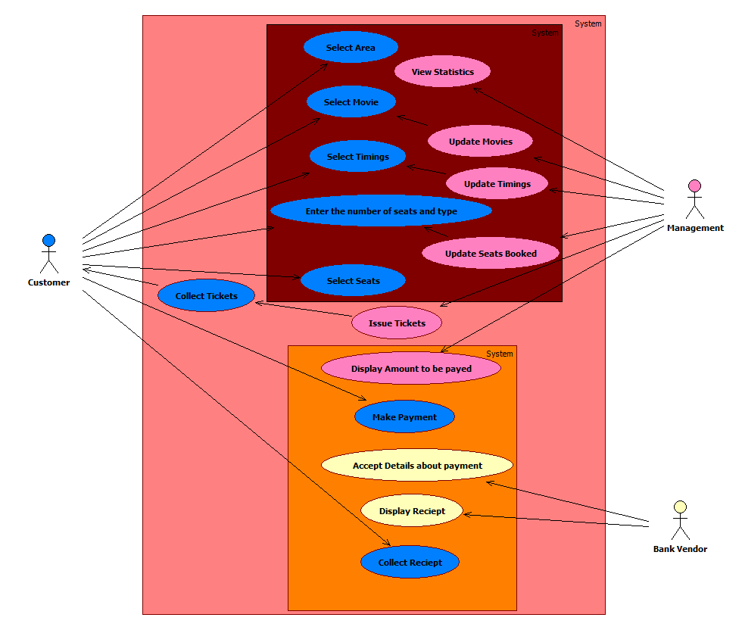
Use case Diagram

Slide 9
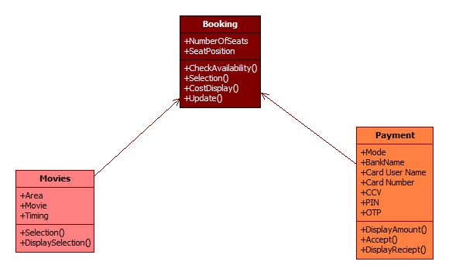
Class Diagram

Slide 10
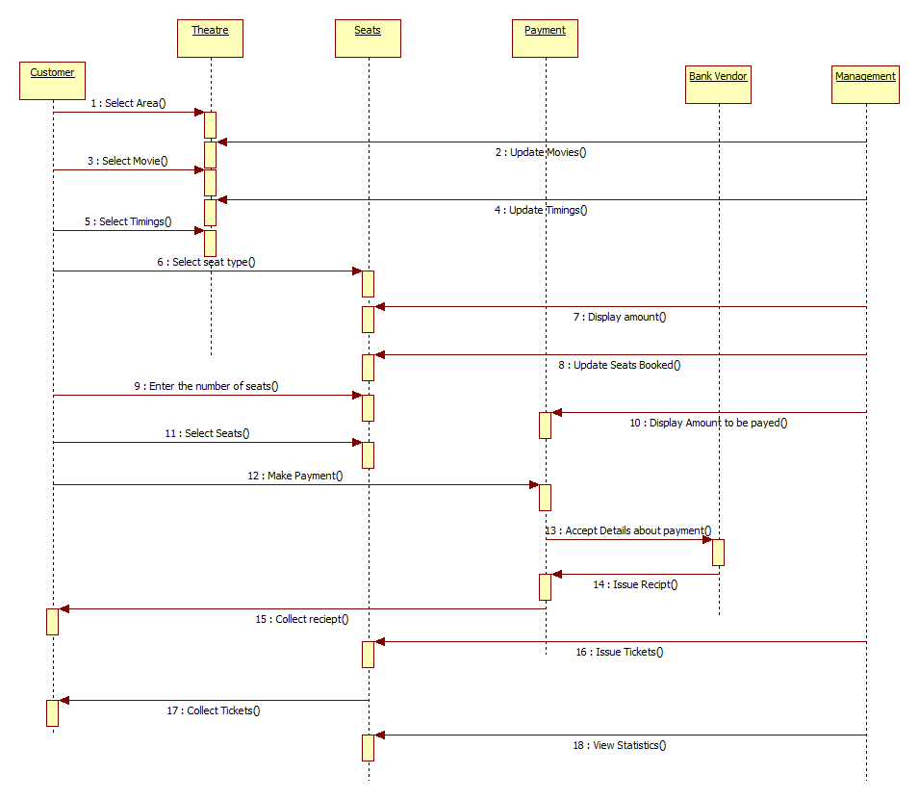
Sequence Diagram

Slide 11

Screenshots

Slide 12
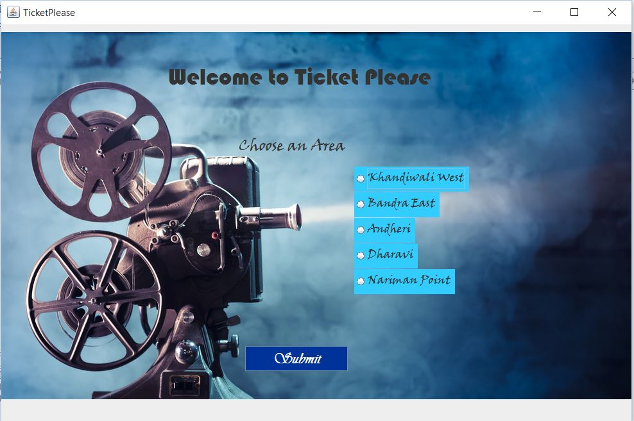

Slide 13
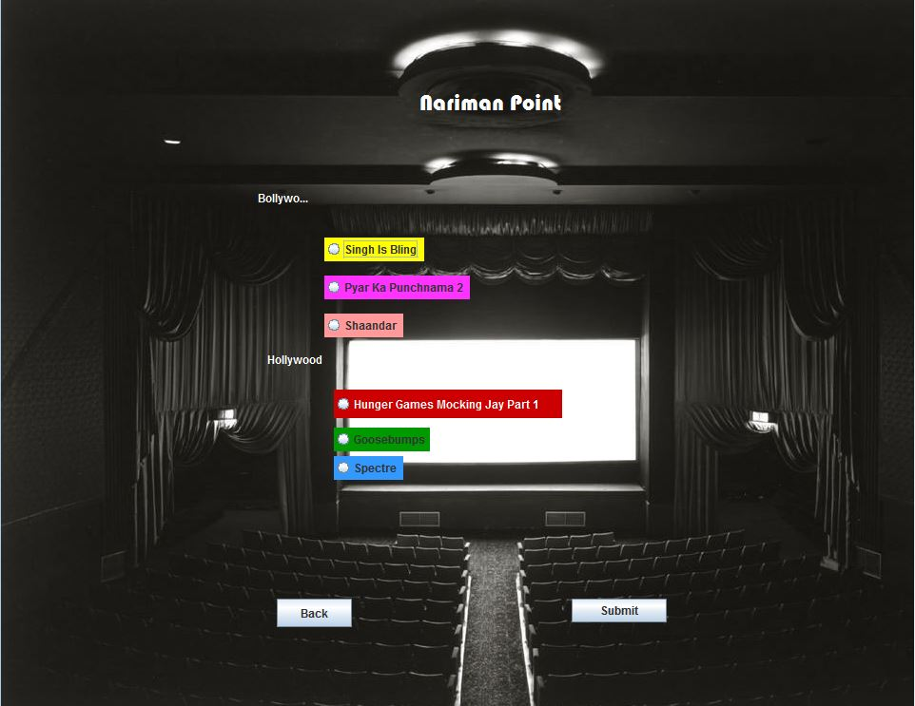

Slide 14
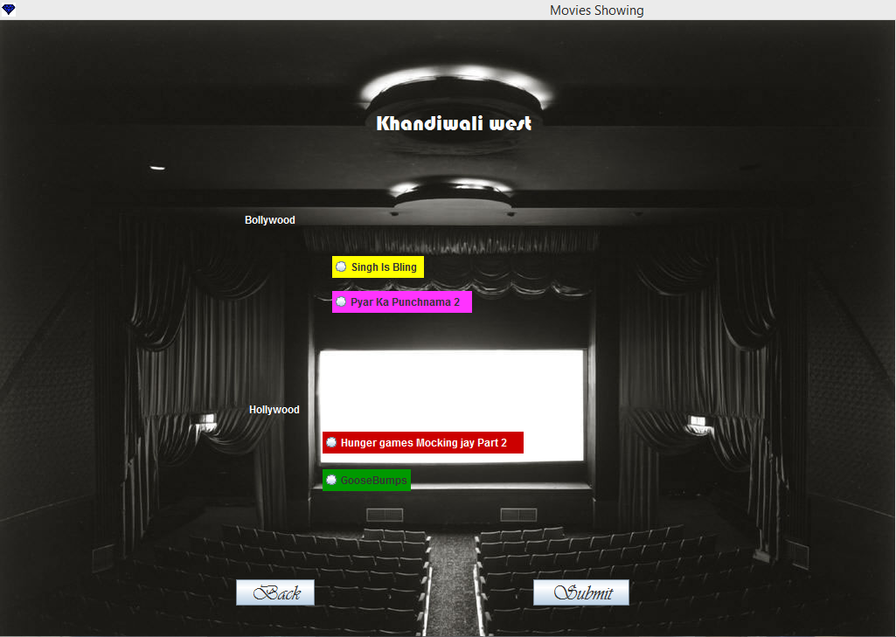

Slide 15
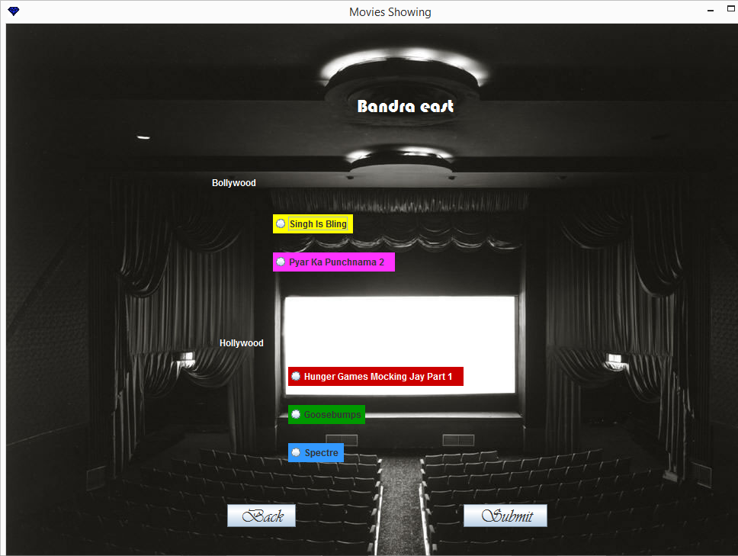

Slide 16
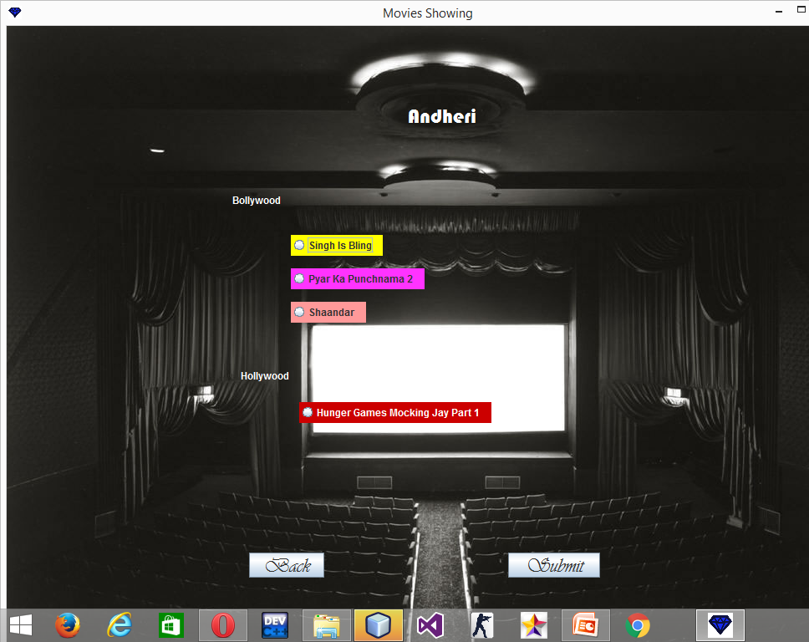

Slide 17
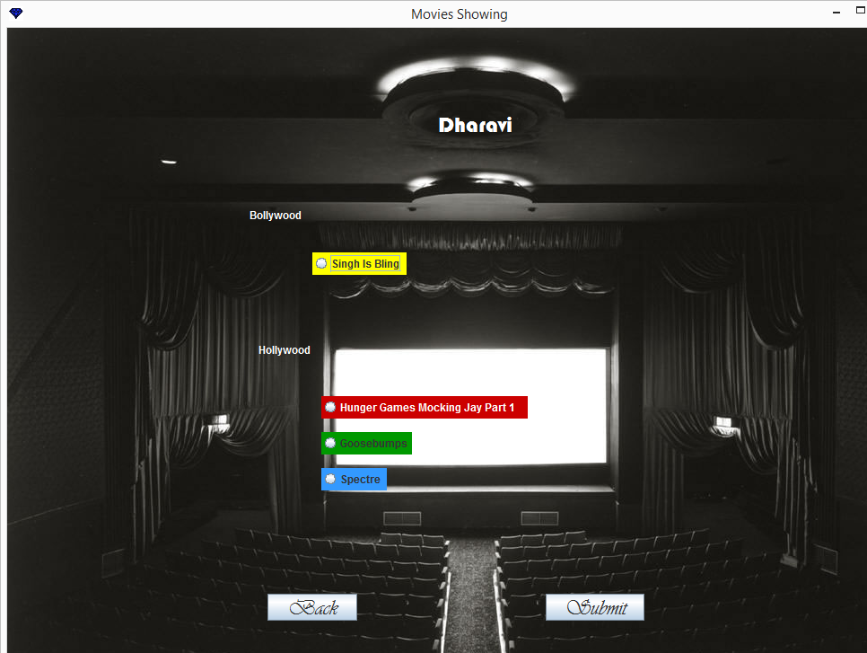

Slide 18
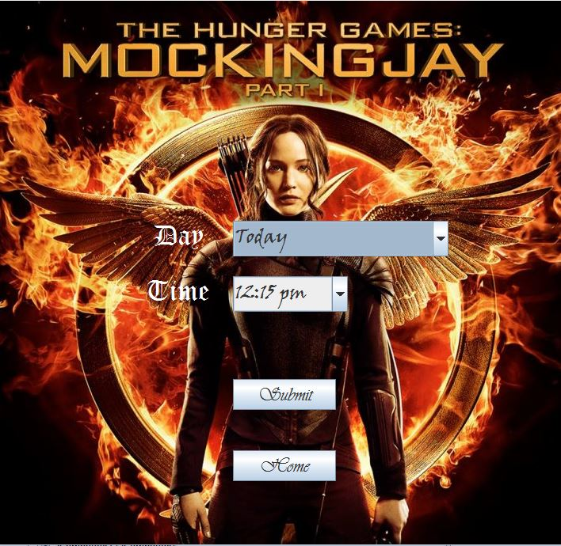

Slide 19
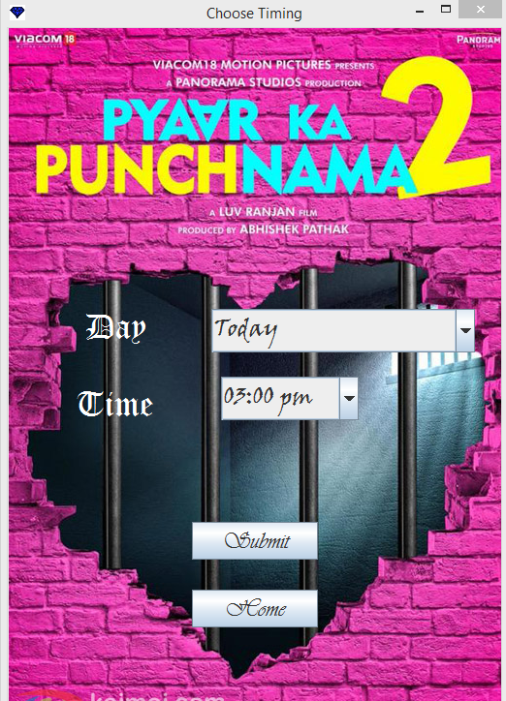

Slide 20
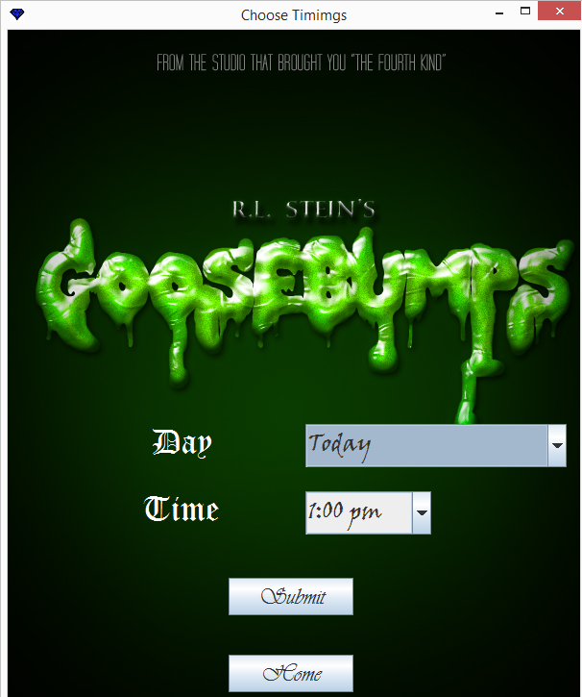

Slide 21
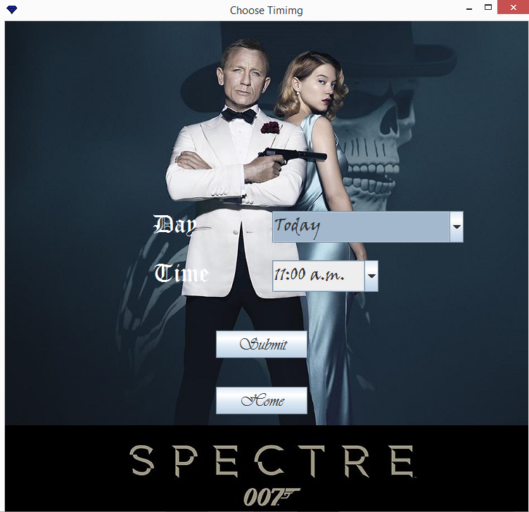

Slide 22
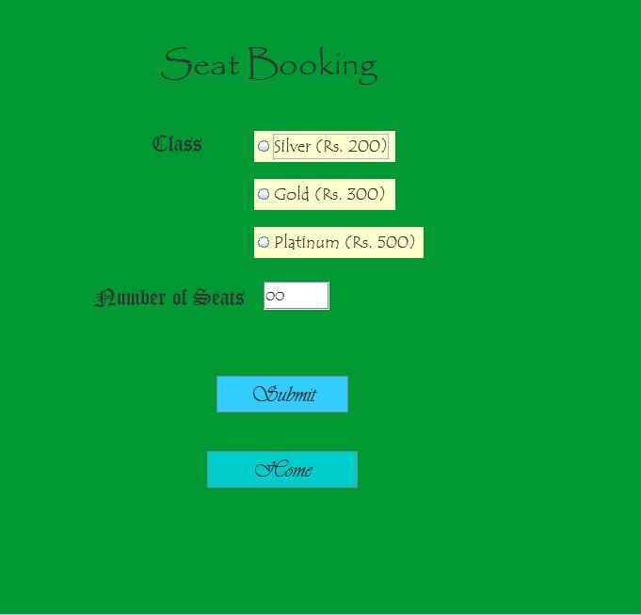

Slide 23
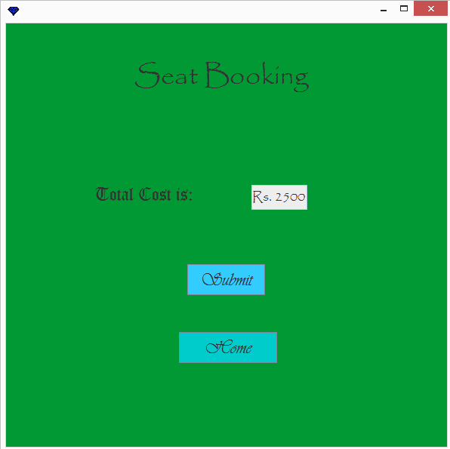

Slide 24
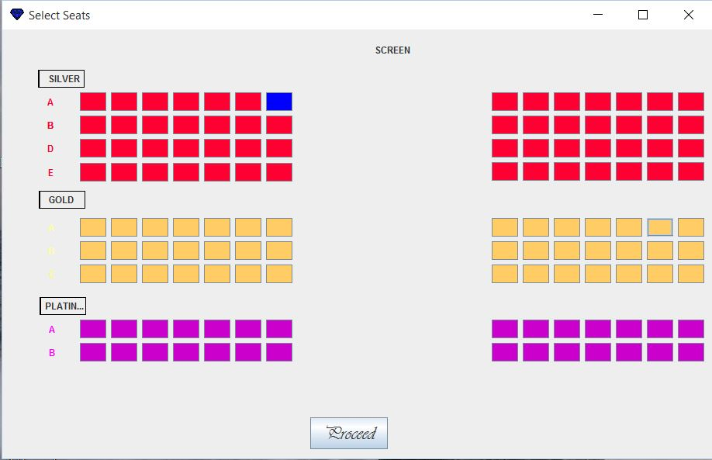

Slide 25
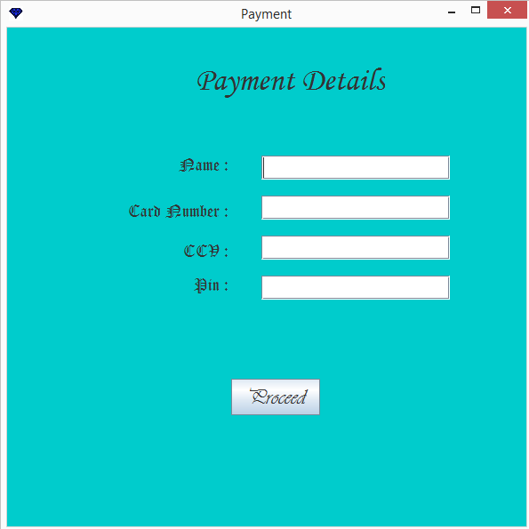

Slide 26
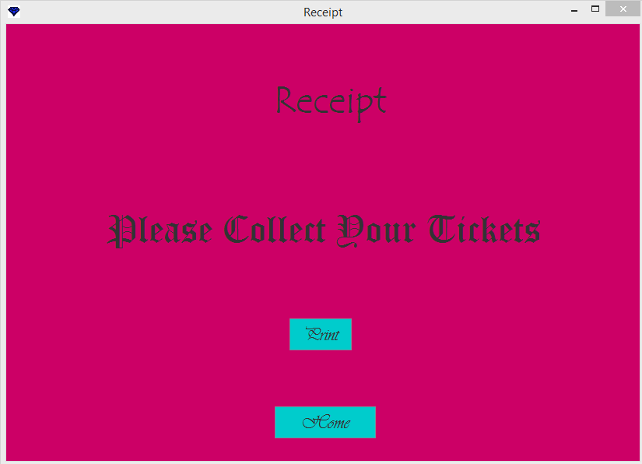

Slide 27


